Slide 1
Art society of Monmouth county
2018-2020
WWW.ARTSOCIETYOFMONMOUTHCOUNTY.ORG

Slide 2
Successful yearS: 2018-2020
Exhibits to show your art
Middletown Township Public Library
Middletown Arts Center
Monmouth Beach Cultural Center
Scholarship funds to pay it forward to a college art student
Fellowship events: Pot Luck Luncheons; Longstreet Farm Tour; Painting Workshops
Meetings to learn from art professionals
Gina Torello pastels demo
David Levy on Italian Renaissance art history
Rich Cali on digital art using iPad Pro
Marie Maber – Art of Morris Blackburn
Kate Grady – Mosaics demo
Nanci France-Vaz – Oil painting demo

Slide 3
OUR officers for 2018-2020
Helen and Ernie Antholis, Co-Presidents
Nancy Cagliostro, Treasurer
Lynne Roemer, VP Membership
Vince Matulewich, VP Exhibits
Sol Hara, Assistant VP, Membership Recruiting
Penelope Marzec, Recording Secretary
Bill Prihel, Corresponding Secretary
Tom Wilczewski, Board Advisor and Publicity Secretary

Slide 4
OUR officers for 2020 -2022
Vince Matulewich and Susan VanVolkenburgh, Co-Presidents
Nancy Cagliostro, Treasurer
Cathy Delano and Caren Flynn, Co-VPs Programs
Lynne Roemer, VP Membership
Linda Hart, VP Exhibits
Sol Hara, Assistant VP, Membership Recruiting
Penelope Marzec, Recording Secretary
Helen Antholis, Corresponding Secretary
Publicity Secretary, Lynne Roemer
Tom Wilczewski, Board Advisor

Slide 5
Exhibit Chairs 2018-2020
Pat Dygulski - October All Art at Monmouth Beach Cultural Center
Lynne Roemer – November Anniversary Show at the Middletown Arts Center
Vince and Irene Matulewich – January The Toni Wilczewski Memorial Photography Show at MTPL
Ken and Joyce Klohn; Helen and Ernie Antholis – March Oldies but Goodies at MTPL
Linda Hart – April The Ruth Crown Memorial Exhibit at MTPL

Slide 6
thank you to our Volunteer Assistants
Patty Chasey, Mary Ann Crane, Cathy Delano, Johanna Ericson, Caren Flynn, Stephanie Frank, Guido Guazzoni, Dana McKay, Pat and Steve Meko, Jim Powers, Donna Robatto, Marianne Salimbene, Greg Sliwa, Lee Sliwa, Theresa Trocchia, Bob Warwick, Lois and Joe Wilkes, Susan Van Volkenburgh, Pat Zackman
Hospitality: Lorraine Kornett, Nancy Nadler and others

Slide 7
Innovations from 2018-2020 – Building on the past
Upgraded accounting methods, established a budget, increased income, reduced expenses
Secured insurance for Directors and Officers
Upgraded Membership record-keeping
Received first grant from OceanFirst Bank Foundation
Gave two scholarships to Brookdale art students
Improved board and member communications
Ran two Copy Cats exhibit categories
Started Saturday Receiving Days
Offered watercolor painting workshops
Conducted a Longstreet Farm Tour – Holmdel Park
Ran three Pot Luck Luncheons
Conducted a fundraiser at MTPL – Trash to Treasure
Started Give Away-Take Away Tables
Exhibited at new venues: Brookdale CC Art Gallery and the Middletown Arts Center
Conducted six exhibits in one year (2018-2019)

Slide 8
New year – value of membership
Social interactions through virtual meetings and mingling with creative artists
Educational opportunities to continue learning from other professionals
Opportunity to exhibit artwork and gain recognition and awards
Chances to contribute time and talent to the mission of the ASMC
Place to use your creativity and keep your mind active
Many different ways to offer assistance to further the continuation of the Society

Slide 9
ASMC by the numbers
100+ members
Commitment of Volunteer Officers with time and talent: 9
Involvement of additional volunteer members: 22
4-5 Exhibits per year
6 Presentations per year
Financially sound with operating budget of $8000 per year
Grants and sponsorships received each year of over $1100

Slide 10
Join us and offer your commitment
WAYS YOU CAN HELP:
RECEIVE ARTWORKS AT ART EXHIBITS
FIND NEW LOCATIONS FOR ART EXHIBITS
RECOMMEND GUEST SPEAKERS
APPLY FOR GRANTS
DEVELOP ANNUAL BROCHURE
CREATE EXHIBIT BROCHURES
ORGANIZE NEW EVENTS
VOLUNTEER for OPEN POSITIONS

Slide 11
POSiTIONS FOR 2020-2022 ELECTIONS WERE HELD IN JUNE 2020
PRESIDENT OR CO-PRESIDENTS – Plans and oversees all activities and volunteers
VP PROGRAMS – Manages Guest Lectures for meetings
VP EXHIBITS – Manages Exhibits (obtains ribbons and supports Exhibit Chairs)
EXHIBIT CHAIRS – Prepares for and Sets up Exhibits (Dates, Judges, Ribbons, etc.)
PUBLICITY SECRETARY – Issues press releases, manages social media
EMAIL COMMUNICATIONS – Uses MailChimp to communicate with members
WEBSITE MANAGEMENT – Uses JIMDO to update the website
PARLIAMENTARIAN – Uses Roberts Rules of Order at Board Meetings

Slide 12
EXPRESS YOUR INTEREST – OFFER TO HELP
CONTACT ANY BOARD MEMBER
INFO@ARTSOCIETYOFMONMOUTHCOUNTY.ORG

Slide 13
New Year is planned already FOR 2020-2021
Exhibit venues are scheduled and booked (4 exhibits)
Most Guest Speakers for meetings are booked
New brochure is in development
Website is up-to-date
Scholarship is fully-funded
New virtual events are in the planning stages
New grant has been applied for from OceanFirst Foundation

Slide 14
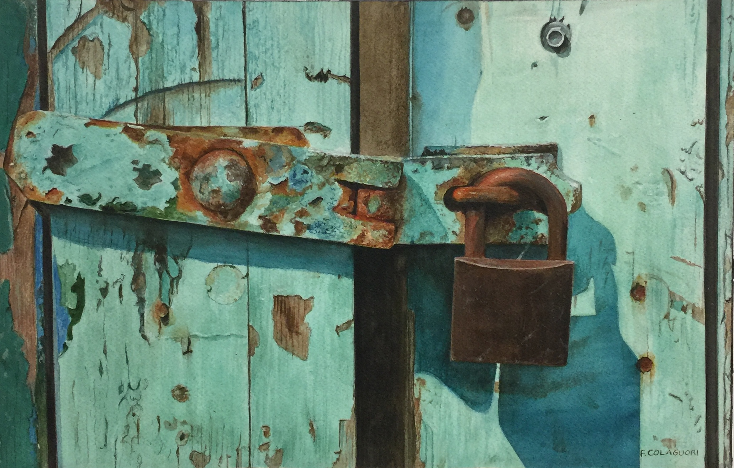
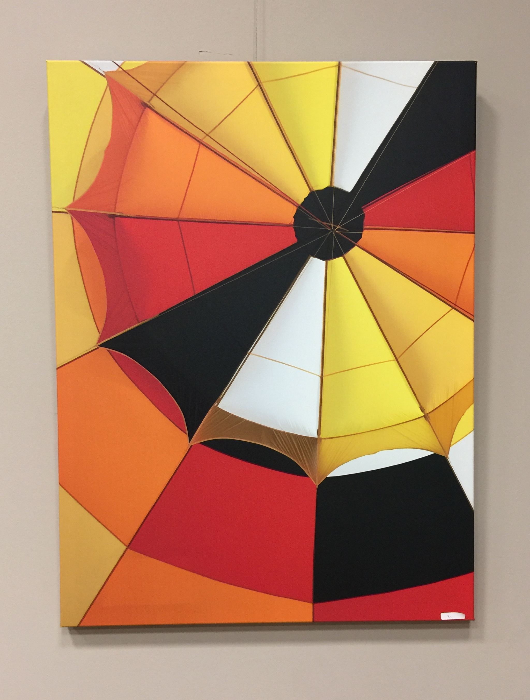
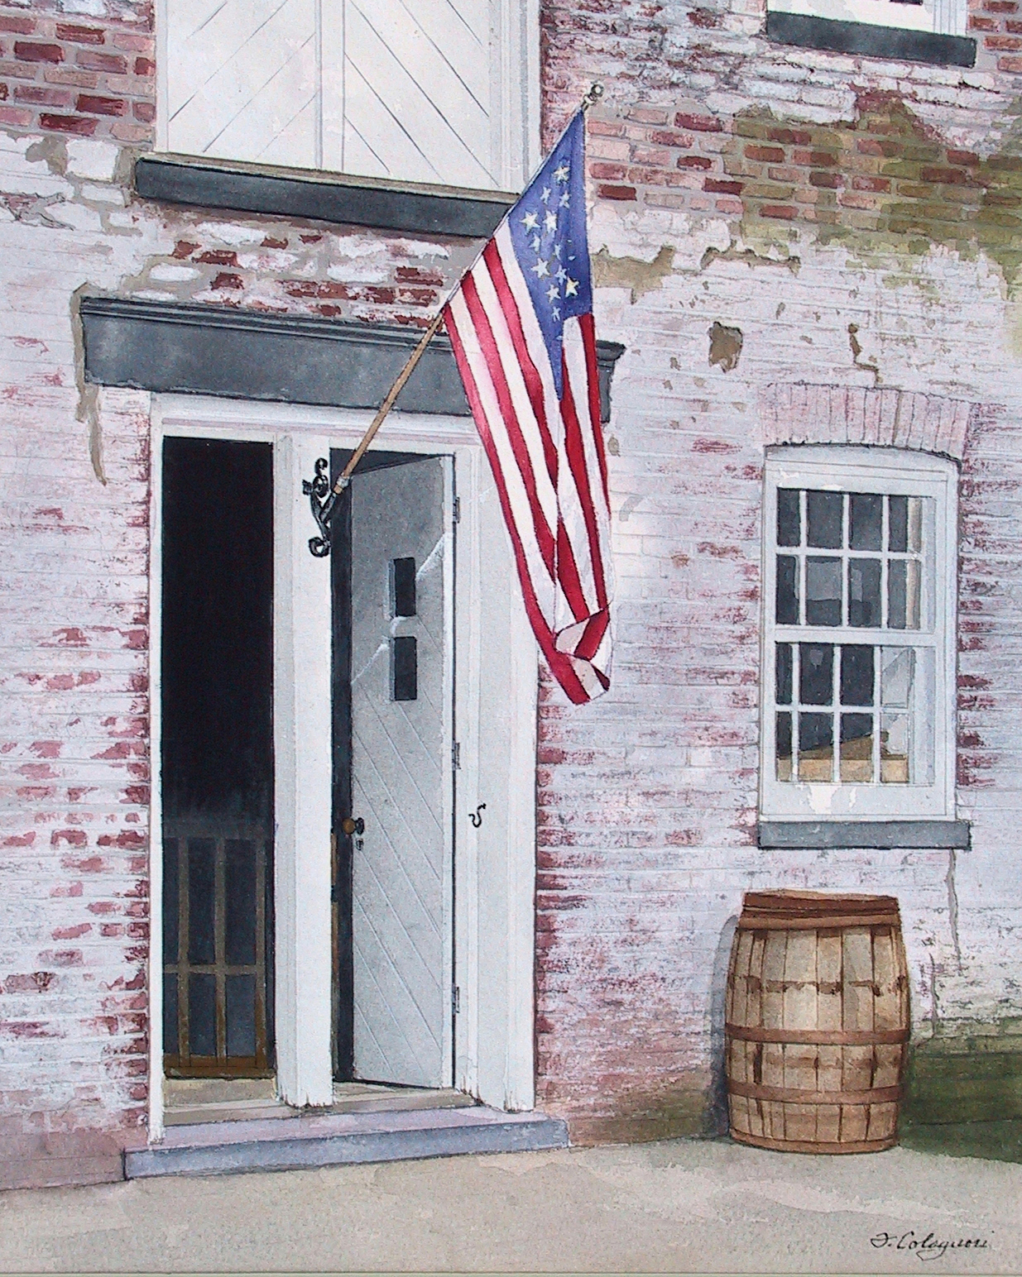
TO ANOTHER GREAT YEAR WITH YOUR HELP!

