Slide 1
The Art Society of Monmouth County
Presents
How To Photograph Your Art
By Vince Matulewich

Slide 2
OUTLINE
Artwork Preparation
Camera Selection
Location
Photographing Subject
Post Production:
    = Image Editing
    = Preparing Image for Show Submission
Notes:
PLEASE SAVE YOUR QUESTIONS FOR THE CONCLUSION OF THE PRESENTATION, WE HAVE 21 MORE SLIDES FOR YOU TO VIEW

Slide 3
Artwork Preparation
● If artwork is under glass, the glass should be removed. If not, you must consider “Glare” and “Reflections” when taking your photograph of the artwork.
● Recommendation – After completing your artwork, you should automatically photograph the work and place it into a digital archive. The archive, if stored in the “cloud” or on a redundant hard drive, will provide a catalogue of your works. From this catalogue one can select images for entering shows or exhibits. The files should be stored in a non-destructive file format such as:
PSD = Photoshop Document (used in Adobe Photoshop, can have layers and is lossless).
PDF = Photoshop - Portable Data File (quickly converts files into PNG, TIFF and JPEG files).
PNG = Portable Net Work Graphic (used for lossless graphic applications).
TIFF = Tagged Image File Format (useful lossless file format, can have layers).
JPEG = Joint Photographic Experts Group (Lossy compression file format,
not my recommendation for archival storage, but used for show entries).
Notes:
QUALITY CAN DEGRADE IF JPEG FILE IS OPENED > AMMENDED > SAVED > OPENED > AMMENDED > SAVED MULTIPLE TIMES, STORE IN AN ARCHIVAL FORMAT

Slide 4
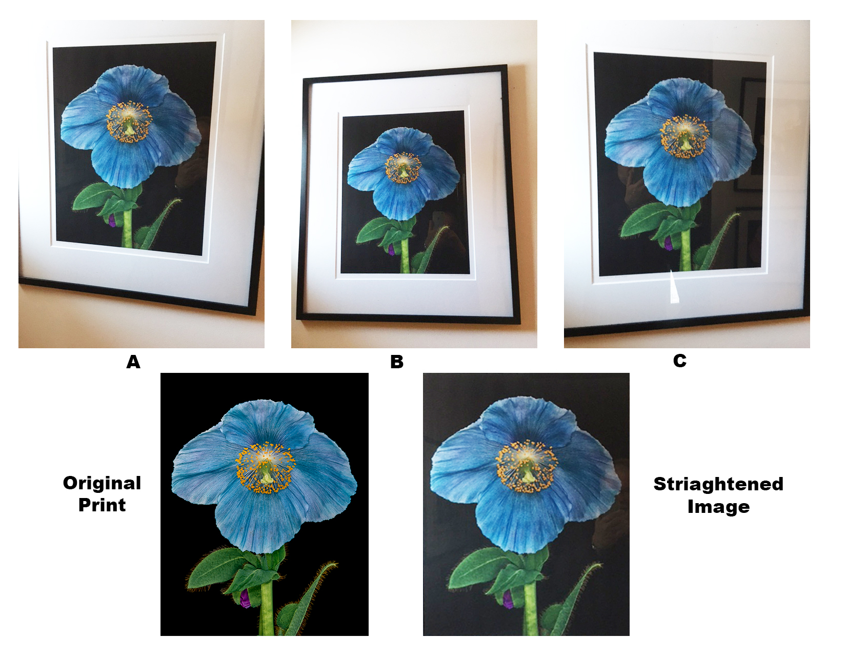
Check For:
Glare
Reflections
Position of Camera to Image

Slide 5
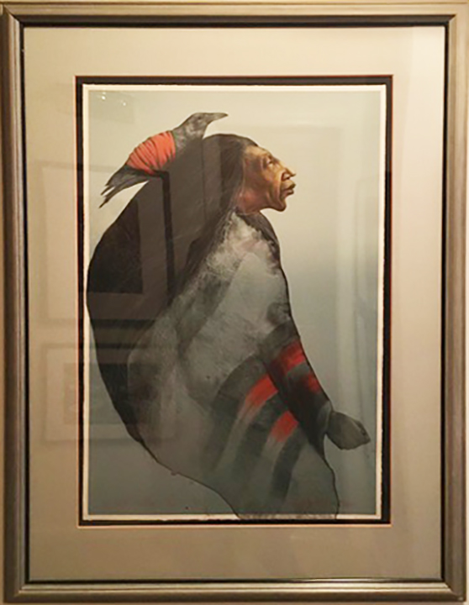
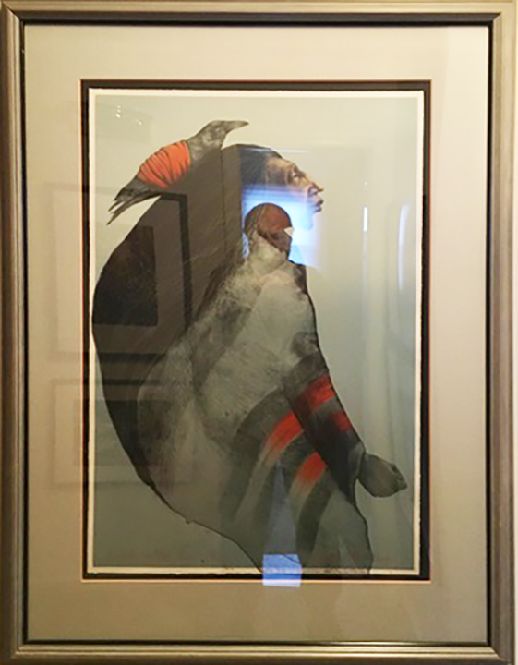
Examples
Reflections
Glare
Notes:
GOOD EXAMPLES OF REFLECTIONS AND GLARE

Slide 6
Camera Selection
● Cell Phone – a constantly-evolving product, new models are rich in photographic capabilities.
● Digital Camera Family (Point and Shoot, DSLR, Mirrorless ( Micro Four Thirds, Full Frame)
- used by photography enthusiasts to professional photographers
Notes:
BEFORE I PUT THIS PRESENTATION, NOT A BIG FAN OF CELL PHONE PHOTOGRAPHY, NOW I’M A CONVERT SHOW CAMERA EQUIPMENT

Slide 7
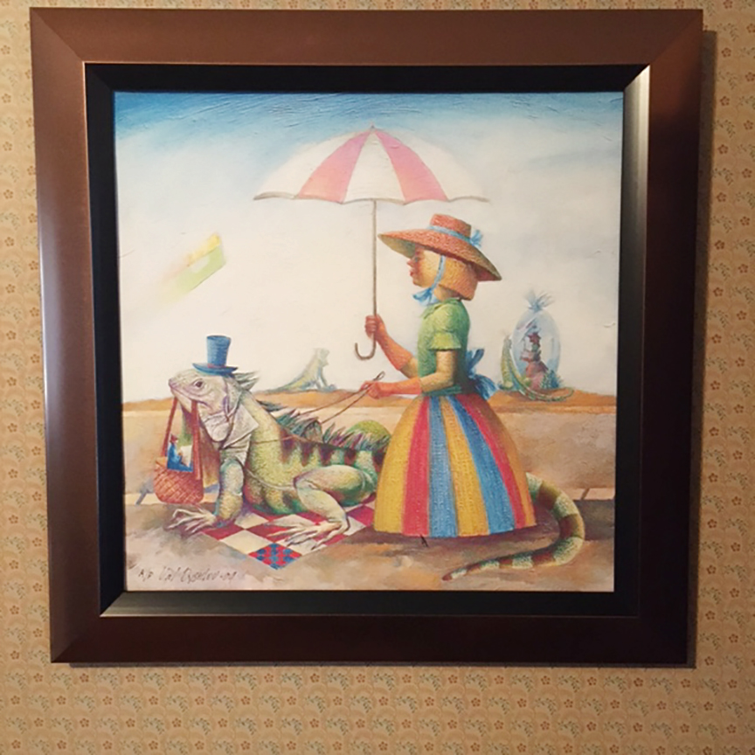
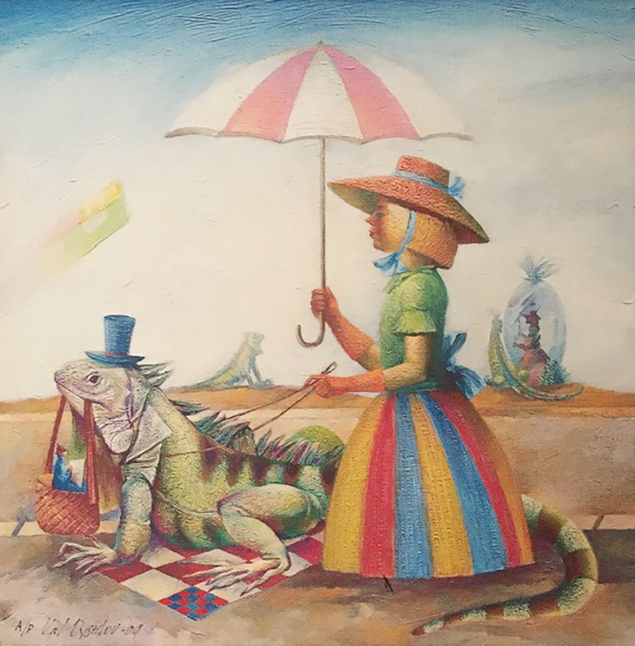
CELL PHONE
Photographed
on wall.
- No glass

Slide 8
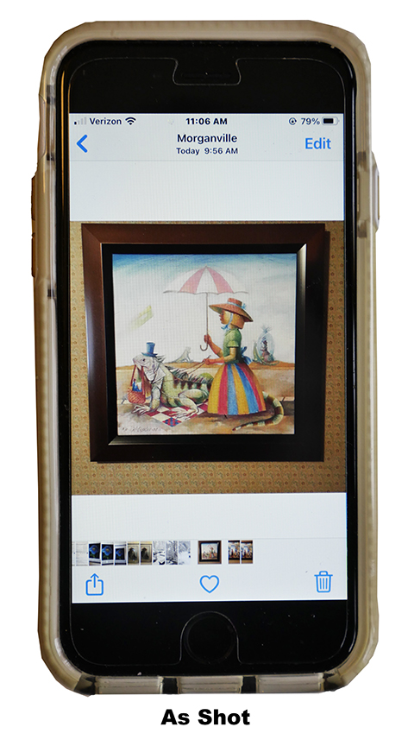
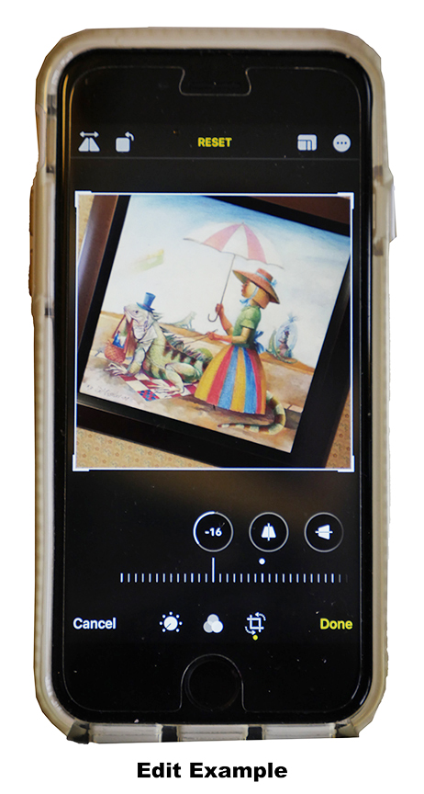
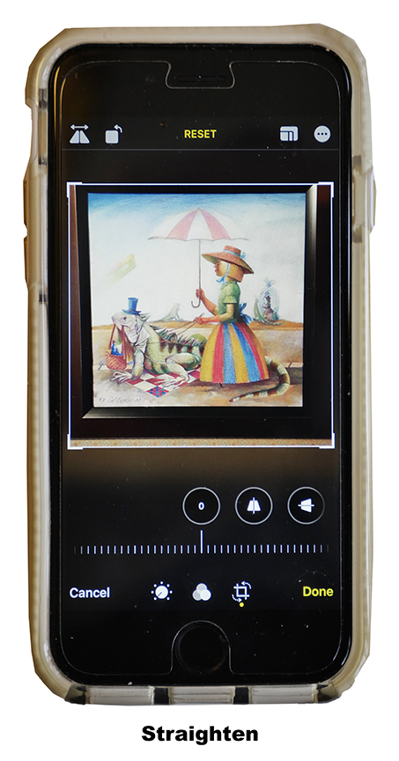
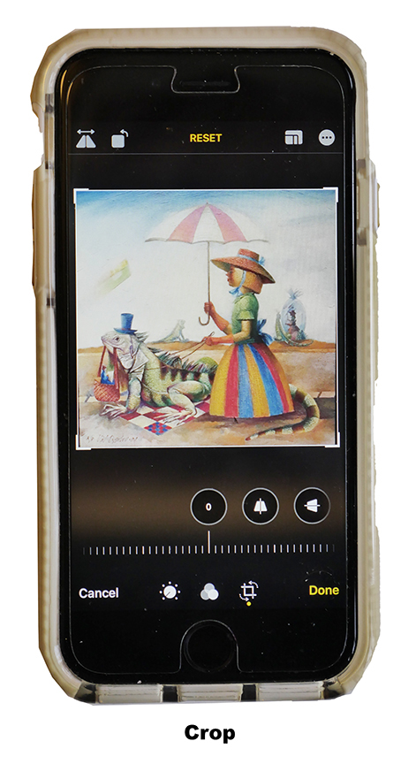
Notes:
DEPENDING ON HOW NEW AND THE MAKE OF CELL PHONE, THE STRIGHTENING AND CROPPING WILL BE EASY OR REQUIRE A BIT OF TIME TO GET IT RIGHT

Slide 9
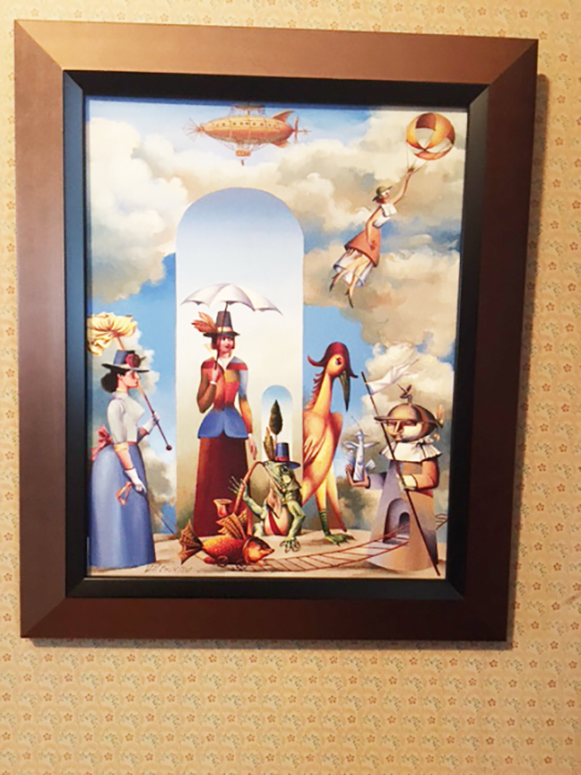
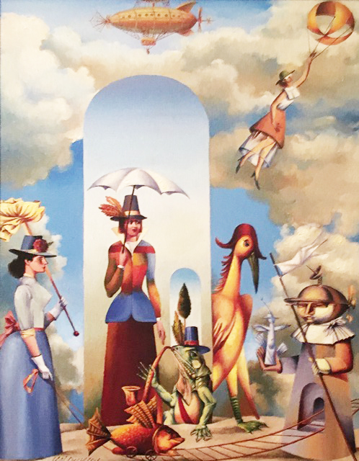

Slide 10
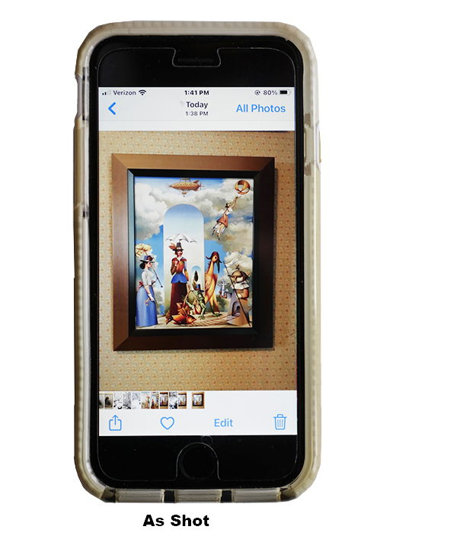
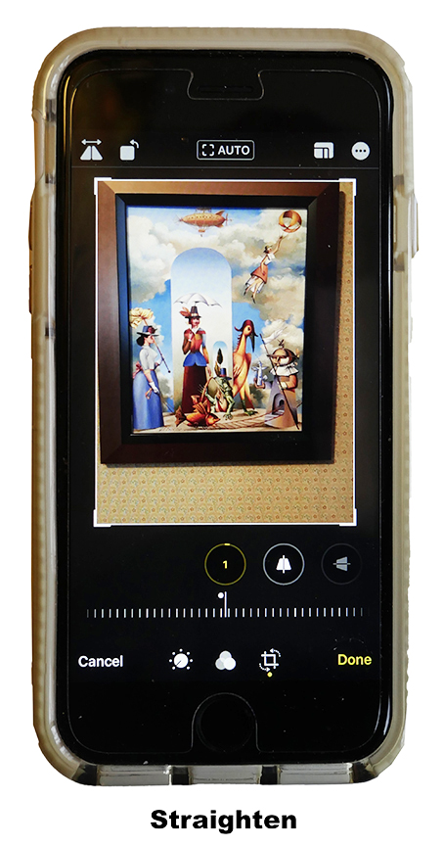
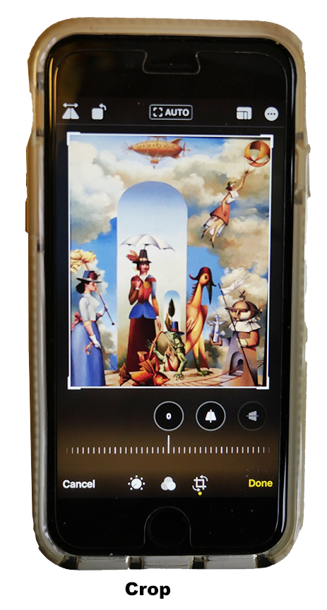
Notes:
NOTE CORNERS

Slide 11
Location
➞ Lighting
- Outdoors - choose a cloudy day or take the photograph in the shade.
- Indoors - no direct lighting, use in-direct lighting.
- place artwork adjacent to a window for indirect lighting.
➞ Support for artwork - place artwork on an easel or chair back, tilted at an angle that is perpendicular (90% angle) to the camera body. You want to shoot straight at the artwork. Frame the artwork so that so that it resembles a rectangle or square and it includes your artwork image. If a portion of the mat is included, this can be removed later (camera aspect ratio).
➞ Use a tripod if you want to become an “Ultimate Techie”.
➞ Check for glare and reflections on camera screen / display. If glare or reflections are noted, move the artwork to eliminate the problems.
Notes:
OUTDOORS MAKE A GOOD CHECK FOR REFLECTIONS FROM BACKGROUNDS

Slide 12
Photographing Subject
➞ Take several photographs of the artwork, ensure that the artwork is in focus. Try using various camera settings from automatic to manual exposure or bracket exposure settings.
➞ Review photographs of your artwork to see if one looks like the original. Check that exposure, focus and alignment are all correct. If problems are noted, start all over. If you have a good set, download image files to your computer. Do not “improve” the look of your image from the original artwork by using imaging editing software. The goal is to have the image look like the original art work.
➞ It is acceptable to increase / decrease the brightness level of an image to match the original work.
Notes:
GOAL = LOOK LIKE ORIGINAL, IMPORTANT FOR JURIED SHOWS AND PHYSICAL DISPLAYING; VIRTUAL SHOWS, NOT AS IMPORTANT AS LONG AS NO EXPETATION OF SALE, BUT IT IS CHEATING

Slide 13
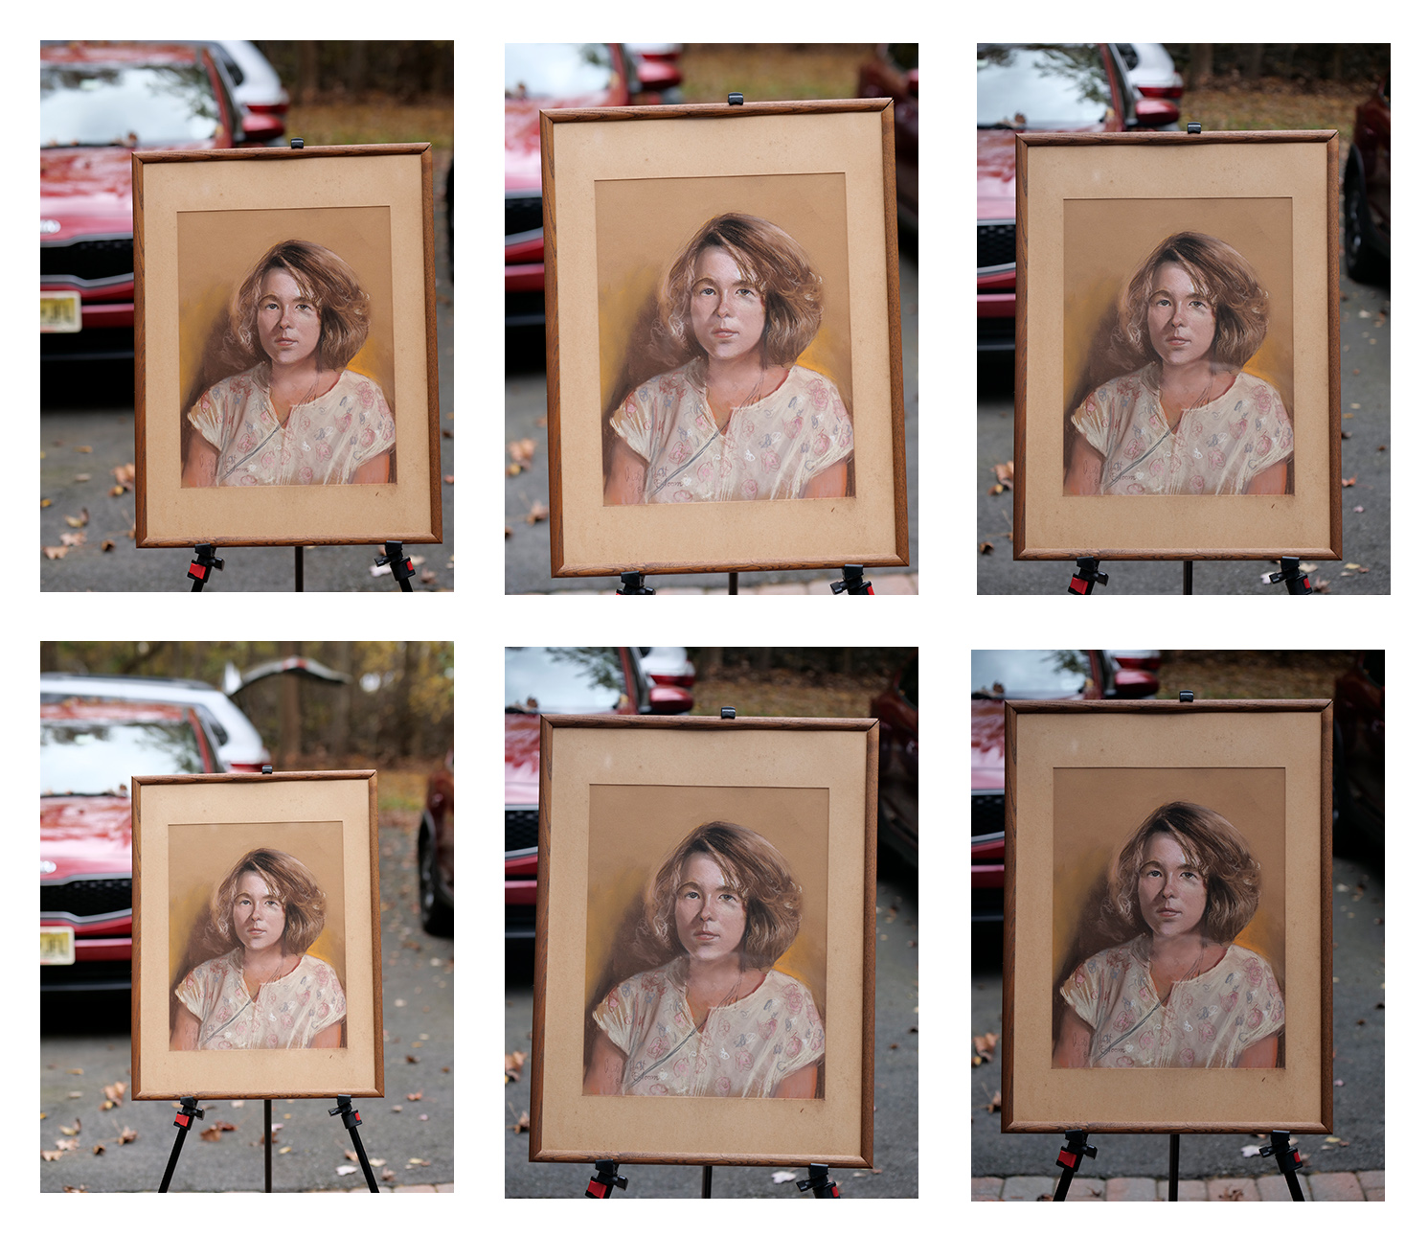
Take Multiple Exposures of your Art Work
- applies to all cameras,
Cell Phone and
other digital types.
- check all for crisp focus.
- select the one that best
represents your Artwork.
Notes:
ACTUALLY TOOK 12 PHOTOS OF SUBJECT, VARING EXPOSURE (F STOP & SPEED) AND MY POSITION RELATIVE TO THE SUBJECT TO REMOVE GLARE

Slide 14
Post Production:
Image Editing
=initialize file - set color space to sRBG and bit depth = 8 bits (image editing software)
=crop photo - to remove frame and mat.
= If photo is not rectangular in shape, you need to find a menu item in your editing program that allows you to fix the skew or distortion. Place a “Guide Line” at the corners of the image, so that all of the image is contained within the created box. It is ok to have unwanted material in the box.
= If editing program has layers, make a duplicate layer, find “File” or “Edit” ➞ “Transform” ➞ “Distort”, pull out the corners of the image to fit inside the box. Then use the “crop tool” to create your undistorted image.
Notes:
COLOR SPACE AND BIT DEPTH SET WITH IMAGE EDITING SOFTWARE (DO NOT BELIEVE CAN BE DONE WITH CELL PHONES)

Slide 15
Image Editing Software
● Photoshop Elements - download a free 30-day trial (if purchased, no subscription fee to pay).
This is considered the industry standard for image editing for photographers just getting started in image editing.
Cost: Photoshop Elements 2021 $69.99 to $99.99 depending on current deal.
● Paint Shop Pro download a free 30-day trial of the photo editing program.
Cost: $63.99 to $79.99 depending on version and deal.
● Paint (found as a Windows Accessory); only use if you are familiar with Paint.
- open your file, find upper left drop down arrow,
select “Open” the file should be on your desktop.
- select Resize and Skew.
Resize by pixels, type “1000" in pixel box
- if your photo is not aligned horizontal or vertical,
use the Skew boxes to achieve alignment.
- after you are satisfied, save you file, by going to the same upper left drop down arrow, select “Save As”,
Rena rename the file using the convention shown on the Show Submission Form.
NOTE: The Software listed is not a recommendation to purchase. They are provided as reference only.
Notes:
TRIAL VERSIONS ARE GREAT, MAKE ADJUSTMENTS THEN DO NOT PURCHASE AFTER 30 DAYS OR YOU MAY LIKE TINKERING WITH YOUR ARTWORK AND PURCHASE

Slide 16
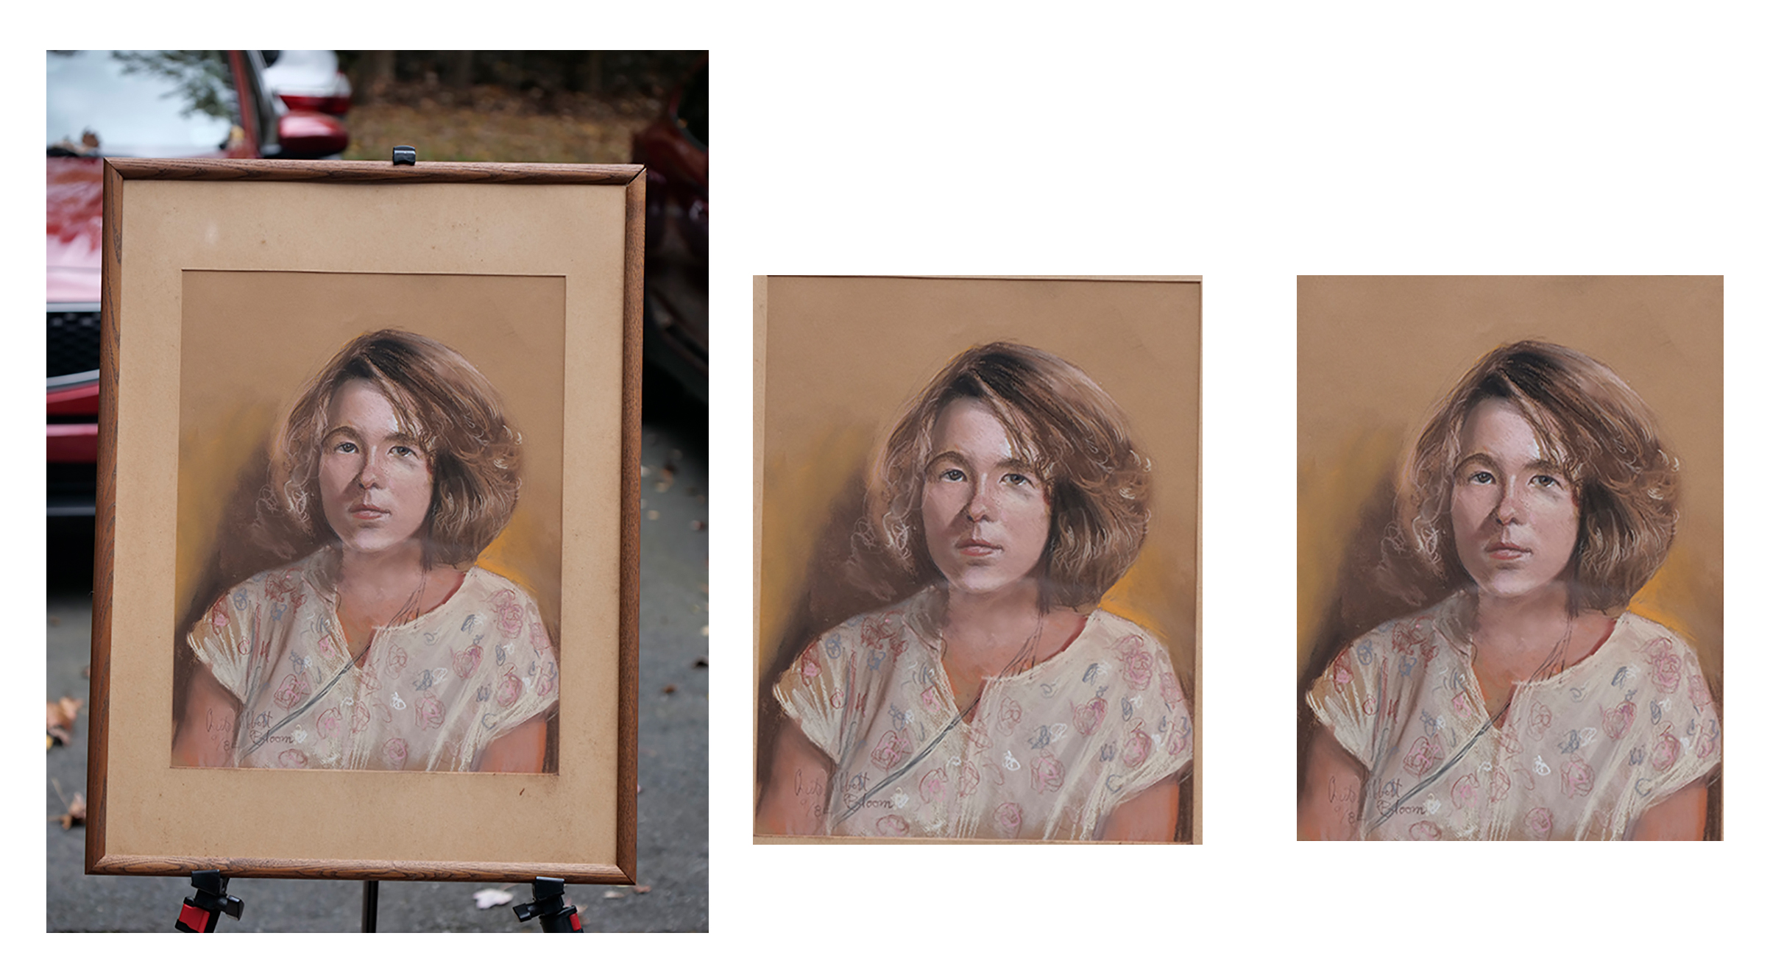
Notes:
NOTE CORNERS

Slide 17
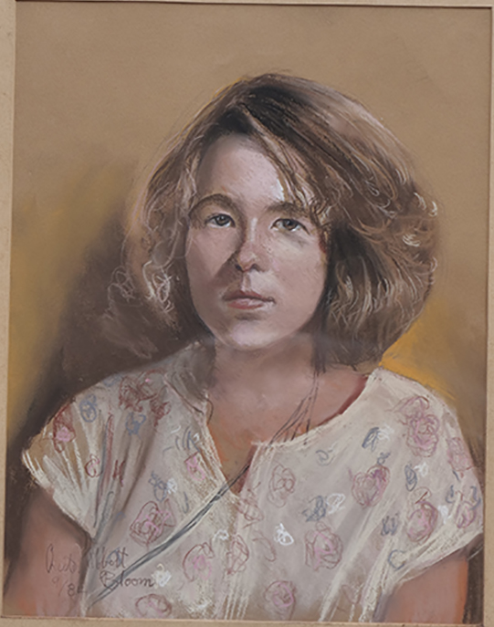
Straighten Image – 1 a
- apply guidelines
(if you have the ability),
then crop image
- or “eyeball” crop.
Notes:
NOTE CORNERS

Slide 18
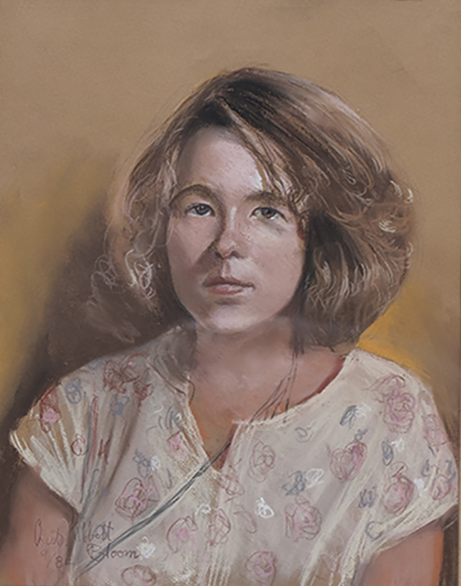
Straighten Image – 1 b
- using image editing software
pull the corners to the rectangular
guidelines.
- crop using the guidelines.
Notes:
FINISHED

Slide 19
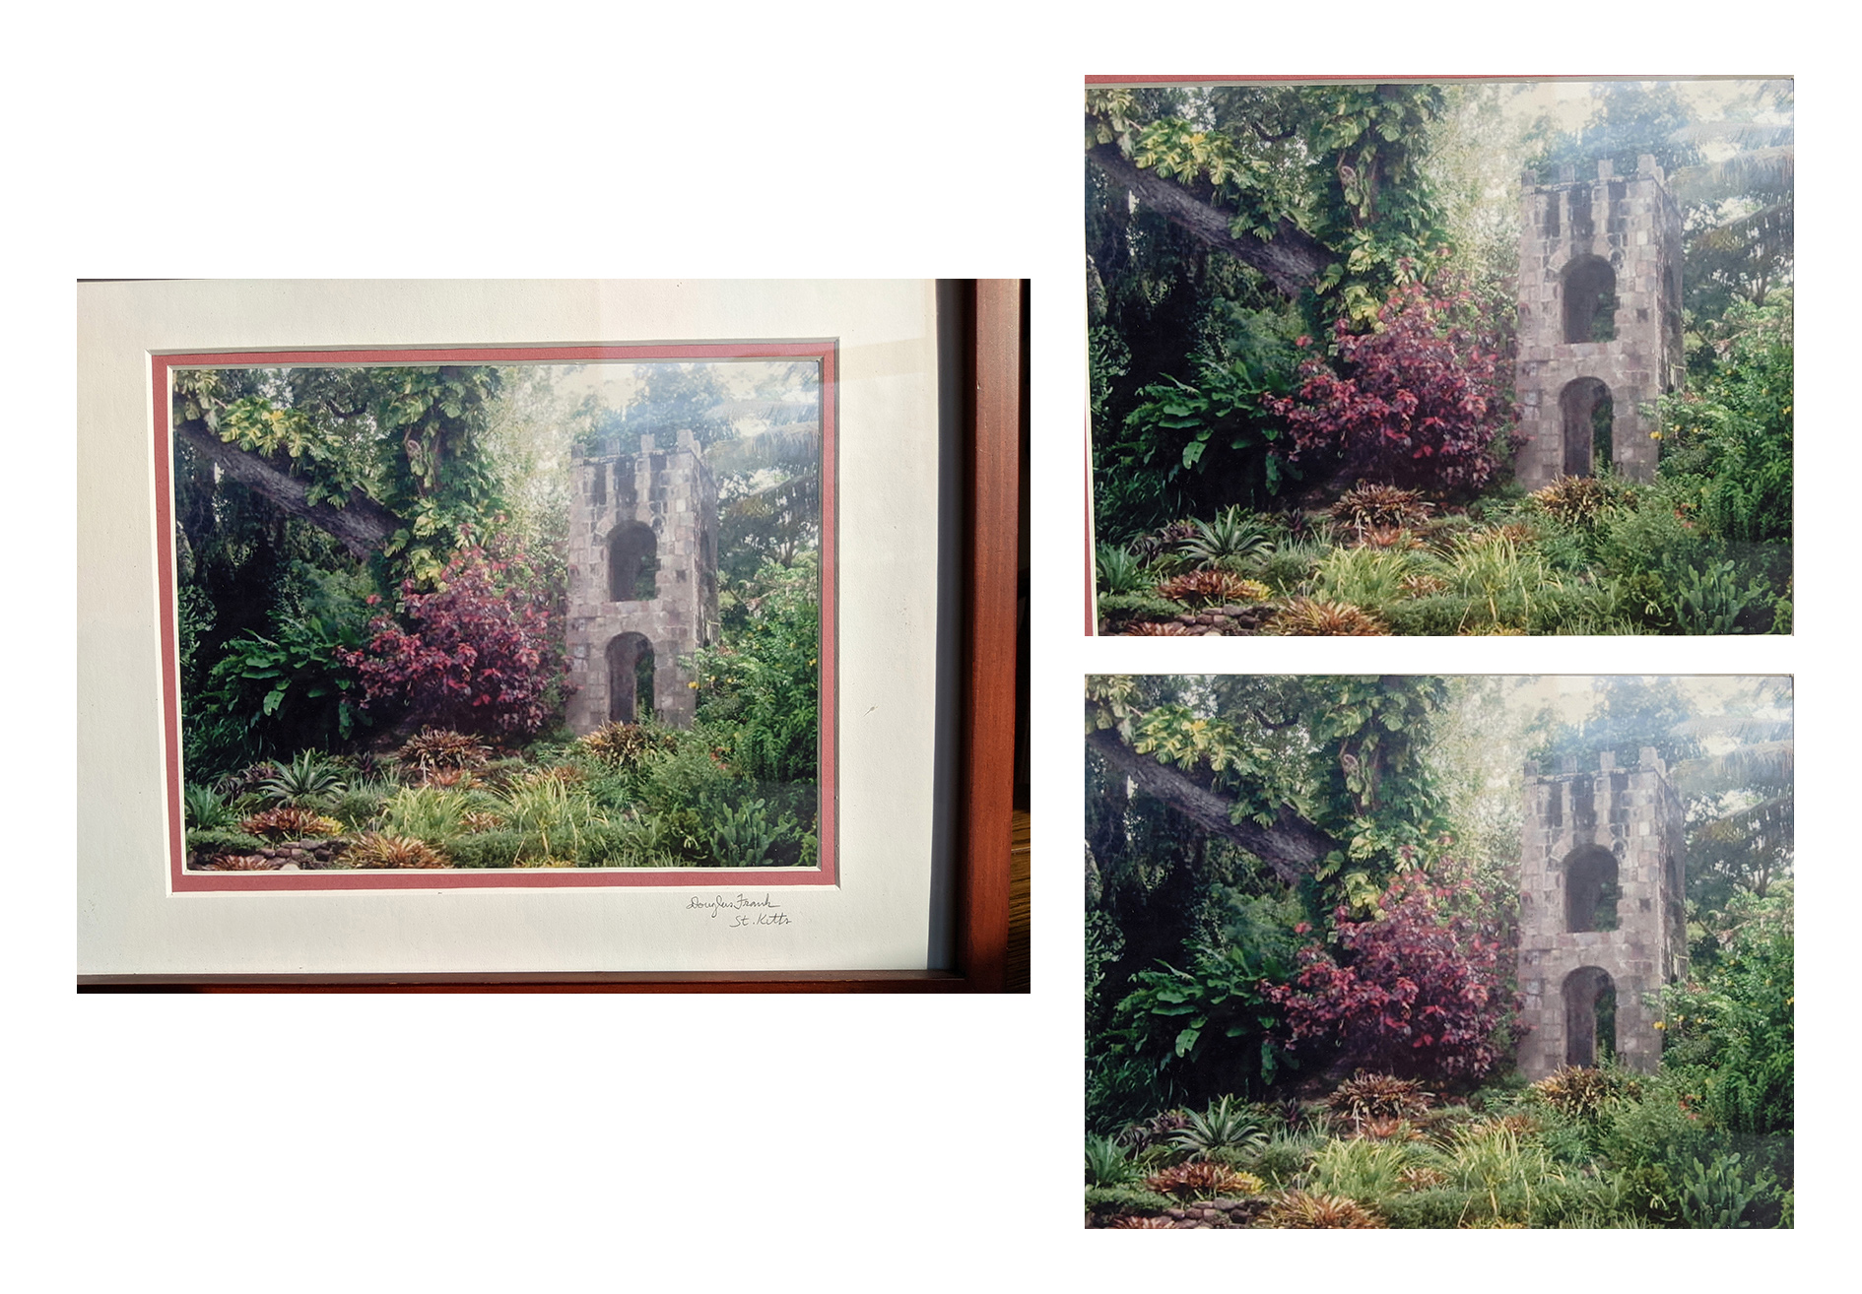
More Examples
-
Notes:
NOTE CORNERS

Slide 20
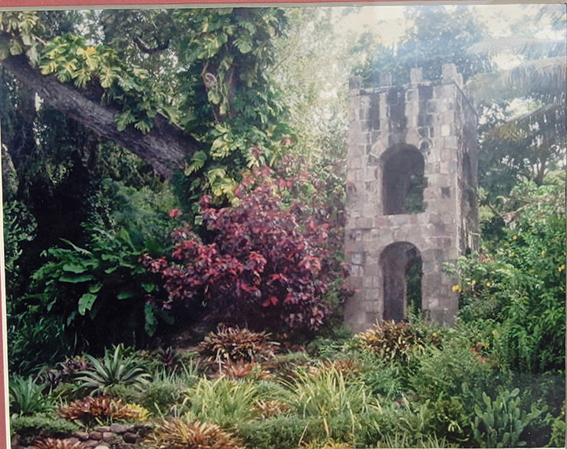
Straighten Image
– 2 a
Notes:
NOTE CORNERS

Slide 21
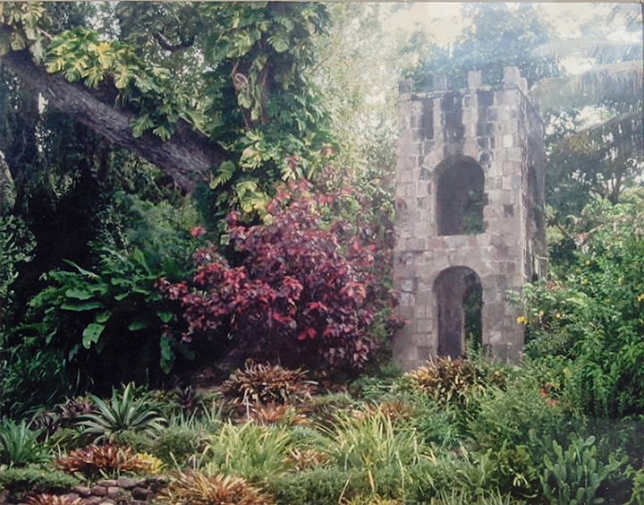
Straighten Image
– 2 b
Notes:
FINISHED

Slide 22
Preparation of Image for Show Submission
➔ Preparing JPEG files for Submission
A standard format for storing photographic files on digital devices (computers, etc.)
Format required for ASMC-OBG submission.
- JPEG Files must be resized to meet requirements.
  Submission Requirements: Resolution = 72ppi, with no less than 1000 pixels long side.
(for Cell Phone: go to App Store - download for resolution “DPI”)
  ➔ Need access to an imaging-editing program to achieve submission requirements or have a high school student do it for you!
  - Resizing JPEG - find a menu that allows resizing, look for “File” ➞ ”Size”
  - check “Maintain Proportions” Box
  - re-size by pixels, set long side to 1000 (short size will automatically be set ).
  (for Cell Phone: go to App Store - download for resizing “Image Size”)
  ➔ Rename your photo -
  - find file in folder or on desktop, left click on file name, type in new file name as
  instructions on show submission form. When finished click outside of new name.
Notes:
HOW DOES ONE RESIZE PHOTOS, NEED IMAGE EDITING SOFTWARE (CELL PHONE NATIVE RESOLUTION IS 180 ppi)

Slide 23
Need Help
If you need additional help you can Google specific questions for Windows or Mac products.
If you cannot remove the frame and mat from a photograph of your Artwork through the use of Image Editing Software or your Cell Phone and want to submit your Art Work to the ASMC’s “Oldies but Goodies Exhibit”, please feel free to send your JPEG file to me and I will straighten your file at no expense to you (FREE!). Your file will be returned to you so that so that it can used it to complete the submission process. You can submit up to two entries for the OBG Exhibit.
If you need to rename the file, I will also do this for you at no cost! All I need is the information that is required for the file name.
E-mail the file or files as an attachment to me at EnviroLawMan@aol.com
Include in the e-mail, as text, the information required for renaming the files.
- I will return the file to you, so that you can complete the submission process.
Notes:
LOTS OF INFORMATION AVAILABLE ON SPECIFIC SOFTWARE HELP AREAS, Q: HOW DO I CHANGE THE RESOLUTION ON A JPEG FILE USING A PC OR MAC?
NAME, PHONE NUMBER, FILE NAME USED FOR SUBMISSION

